Slide 1
JavaScript Event Handling

Slide 2

Overview
Events
How does it work?
Managing JavaScript Events
Mouse Events
Keyboard Events
The onLoad and onUnload Events
Objects and Events
Creating an Event handler
onChange Event
Event Simulation
The Event object
Event capturing
Turning off Event capturing
Event bubbling
Preventing Event bubbling
Introduction

Slide 3
Event Handlers in JavaScript

Slide 4
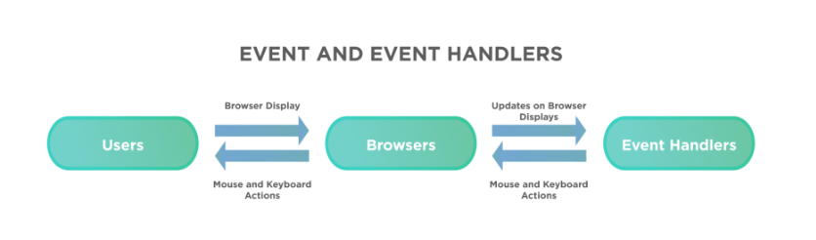
What are Event Handlers in JavaScript?

Slide 5
Types of Event Handlers

Slide 6
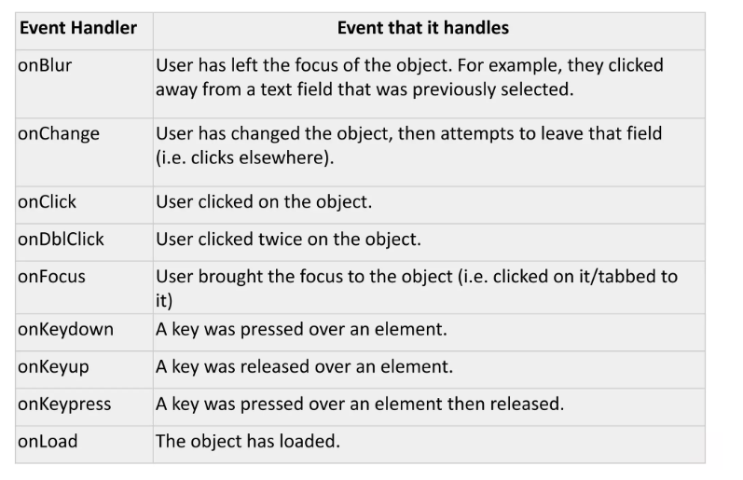

Slide 7
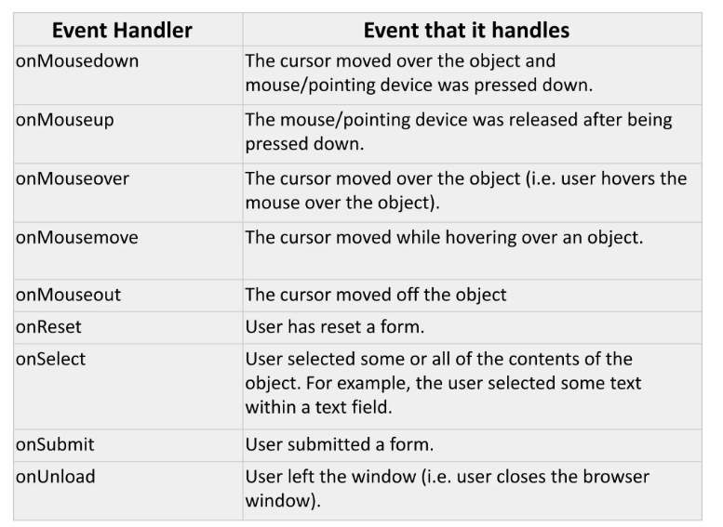

Slide 8
Creating an Event Handler

Slide 9
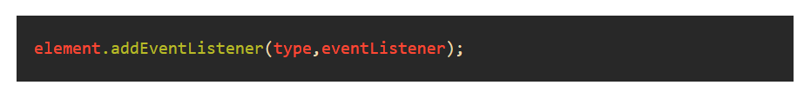

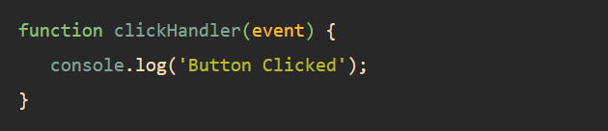

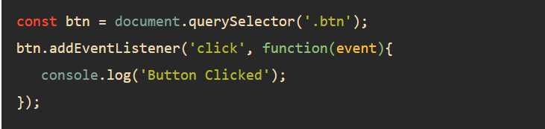
Creating an Event Handler

Slide 10
onchange Event

Slide 11
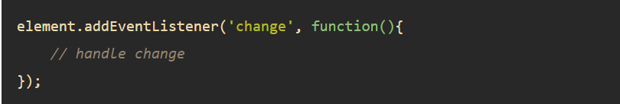
onchange Event

Slide 12
Event Simulation

Slide 13
How to simulate a click with JavaScript ?
element.click()
element.click()
element.click()
To simulate a click with JavaScript we have two popular ways.
Method 1: Using the click() method.
The click() method is used to simulate a mouse click on an element. It fires the click event of the element on which it is called. The event bubbles up to elements higher in the document tree and fires their click events also. The element to be clicked is first selected and the click() method is used. This simulates a click on the element.
Syntax:
element.click()
Method 2: Creating a new CustomEvent.
The CustomEvent constructor is used to create a new event to be used on any element. The CustomEvent interface handles the events initialized by an application for any purpose. The ‘click’ event can be passed to the constructor of CustomEvent to create a click event. This created Event has various properties which can be accessed to customize the event. The element to be clicked on is first selected. The dispatchEvent() method is used on this element to fire the click event. The dispatchEvent() method dispatches an Event at a specified target. This simulates a click on the element selected.
Syntax:
click_event = new CustomEvent('click');
btn_element = document.querySelector('#element');
btn_element.dispatchEvent(click_event);

Slide 14
The Event Object

Slide 15
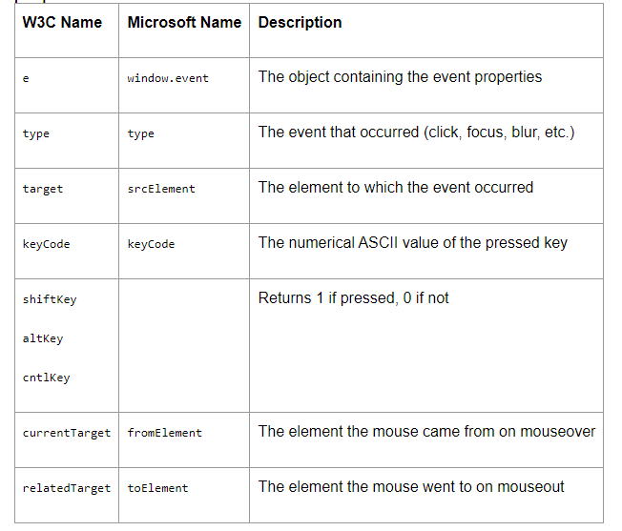
Commonly Used Event Object properties

Slide 16
Determine the type of event
function myEvent(e) {
var evtType = e.type
alert(evtType) // displays click, or whatever the event type was }

Slide 17
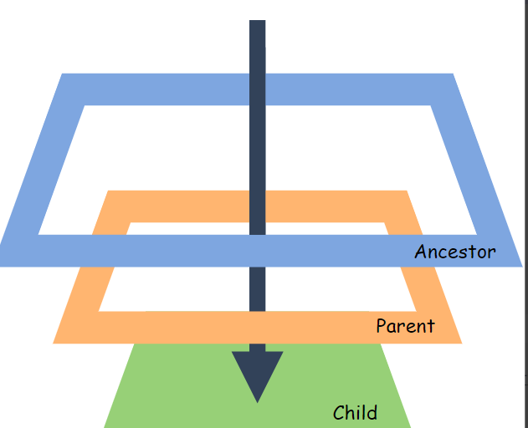
Event Capturing

Slide 18
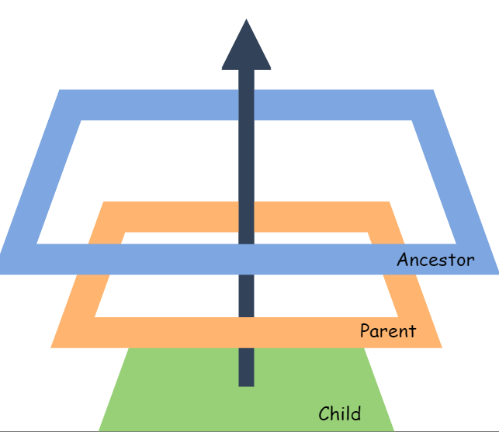
Event Bubbling

Slide 19

Stop Event Propagation

Slide 20
Event handlers are JavaScript code that invoke a specific piece of code when a particular action happens on an HTML element.
The event handler can either invoke JavaScript code directly or via a function.
One HTML tag can contain multiple event handlers and will invoke the code depending on the event/action that happens on the HTML element.
Summary

